Slide 1

Azure ML Prompt Flow
Train the Trainer | Presentation
Ruth Yakubu
Principal Cloud Advocate (AI)
Microsoft @ruthieyakubu

Slide 2
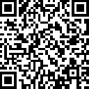
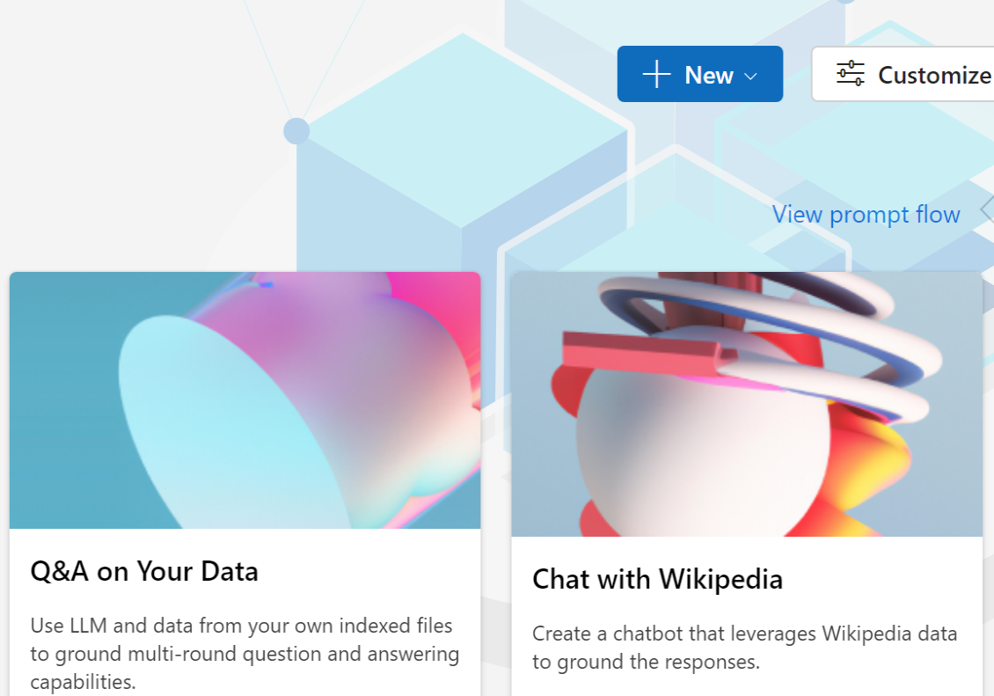
https://aka.ms/rai-hub/azure-prompt-flow
Click icon to add picture

Slide 3
What We Will Cover Today
Prompt Flow features
Flow Evaluation
Exercise: Launch Interactive Lab
Prompt Engineering

Slide 4
Prerequisites
Access to Azure Subscription
Azure OpenAI enabled in your Azure Subscription
Notes:
- Only participants with Azure OpenAI enabled in their Azure Subscription can complete this work workshop.

Slide 5




Introduction
In today's data-driven world, the demand for AI systems to less harmful to individuals and society. Ethical principles has never been more pronounced.
AI innovation is occurring at a rapid pace
Companies are accelerating adoption of AI
Societal expectations are evolving
Governments are regulating AI in response
Notes:
In today's data-driven world, the demand for machine learning models that not only excel in accuracy but also adhere to ethical principles has never been more pronounced.
[Talking points]
AI is here, today all around us, helping to make our lives more convenient, productive, and even entertaining. It’s finding its way into some of the most important systems that affect us as individuals, across our lives, from healthcare, finance, education, and employment.
Organizations have recognized that AI is poised to transform business and society
The accelerated adoption are being met with evolving societal expectations and scrutiny
We are seeing a growing number of government AI regulations in response.
AI has unique challenges that we need to respond to and to take steps toward a better future, we need to define new rules, norms, and practices.

Slide 6
What is Prompt Engineering?
Prompt engineering is a concept in Natural Language Processing (NLP) that involves embedding descriptions of tasks in input to prompt the model to output the desired results.
Prompt typically includes problem descriptions, instructions on how to solve the problem, and examples of correct problem and solution pairs.
Notes:
First, let’s learn what is prompt engineering. Prompt engineering is a concept in Natural Language Processing (NLP) that involves embedding descriptions of tasks in input to prompt the model to output the desired results.
Prompt typically includes:
- Problem descriptions. What tasks the system can provide information on.
- instructions on how to solve the problem. For example, these often include do’s and don’t. Where to get information.
- and examples of correct problem and solution pairs.

Slide 7

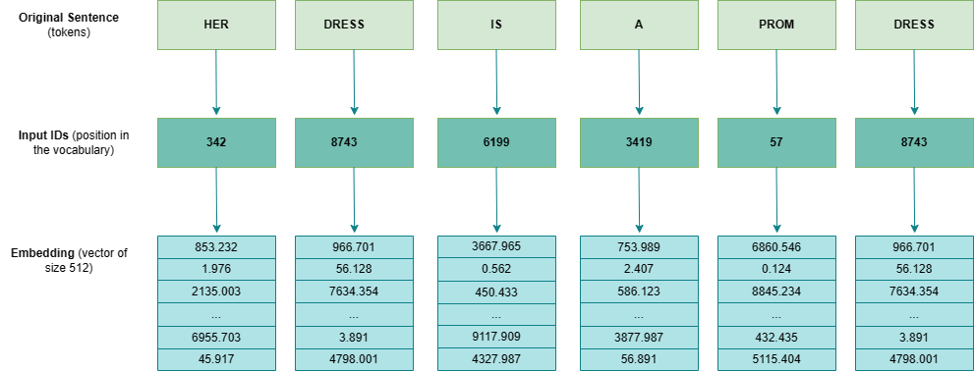

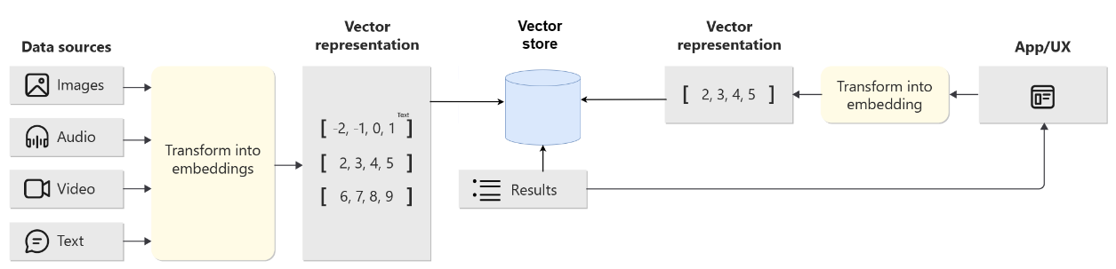

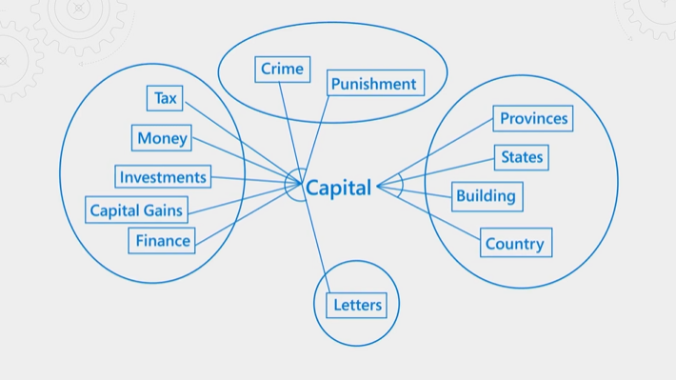
Vectorization & Embedding
Embedding input
Vector index Lookup
Embedding relationship grouping
Notes:
It’s importance for the participants to understand about Vector data source and how the are used with LLMs.
Input text is converted numeric values (also known as tokens). Each number maps to an embedding model’s (e.g. Text-Embedding-Ada-002) dictionary of text or corpus.
- Next, the model groups words in vectors that contains our similar words by meaning.
The Embedding diagram shows how the texts are group in vectors by relationship and meaning
The Vector index Lookup workflow of handling inputs and output
- When inserting your data into a vector database, it will be converted to numeric vector embedding
- The Vector store will create indexes by calculation the nearest neighbor of the words
- When the user submits a prompt input inquiry, the text is converted to numeric vector embeddings in our order to search the vector.

Slide 8
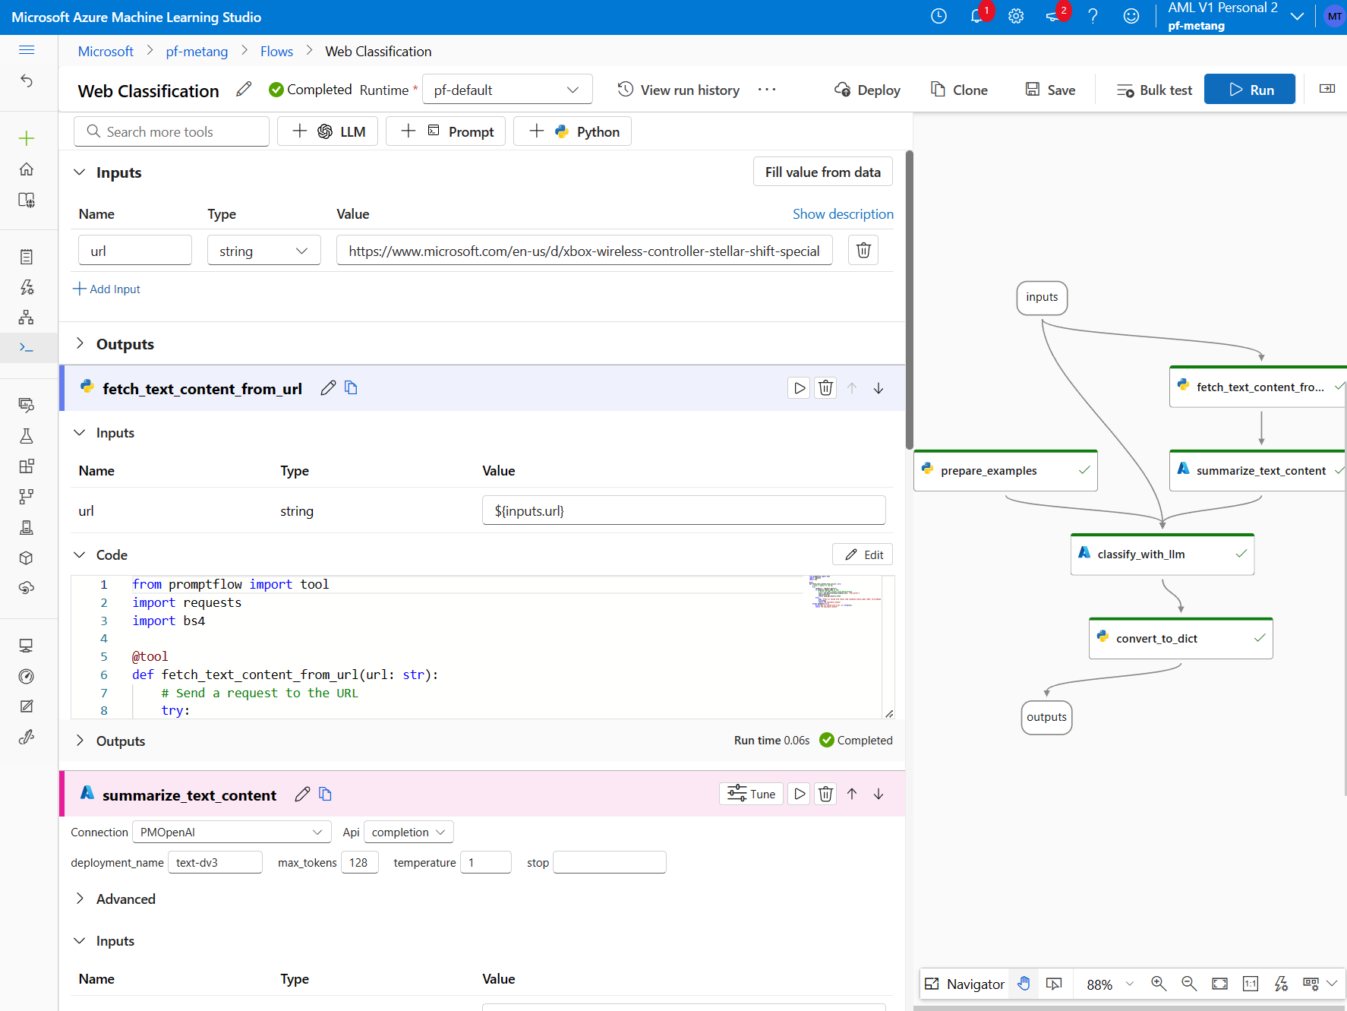
Streamline prompt engineering projects
Azure Machine Learning
prompt flow
Customer Benefits
Create AI workflows that connect various language models, APIs, and data sources to ground LLMs on your data.
One platform to design, construct, tune, evaluate, test, and deploy LLM workflows
Evaluate the quality of workflows with rich set of pre-built metrics and safety system.
Easy prompt tuning, comparison of prompt variants, and version-control.
Documentation: https://aka.ms/prompt_flow
Notes:
Users can leverage Azure Machine Learning prompt flow to build LLM AI solutions.

Slide 9
A shift of addressing Responsible AI
Traditional MLOps
LLMOps
ML Engineers
Data Scientists
ML Engineers
App developers
Target audiences
Model, data, environments, features
LLM, agents, plugins, prompts, chains, APIs
Assets to share
Accuracy, fairness, groundedness, relevance, coherence
Metrics/evaluations
Accuracy
ML models
Build from scratch
Pre-built, fine-tune
Notes:
The evolution of MLOps to LLMOps is something we know organizations struggle with. Building and managing an LLM app today can feel like a bespoke process, combining models, open source frameworks, and manually connecting data sources. For many customers, it isn’t scalable and honestly customers right now are looking for guidance for how their existing MLOps can be augmented to cover these new workflows.
Luckily, while generative AI introduces new users, techniques, and challenges to MLOps, our customers can build on their existing MLOps tools and practices. They are not starting from scratch. For example, pipelines will still be important. Experimentation and tests will also be important – though it may come more naturally to data scientists than developers at first.
What is critical in this new workflow is that enterprises have control such that they can implement the safeguards their businesses require.

Slide 10
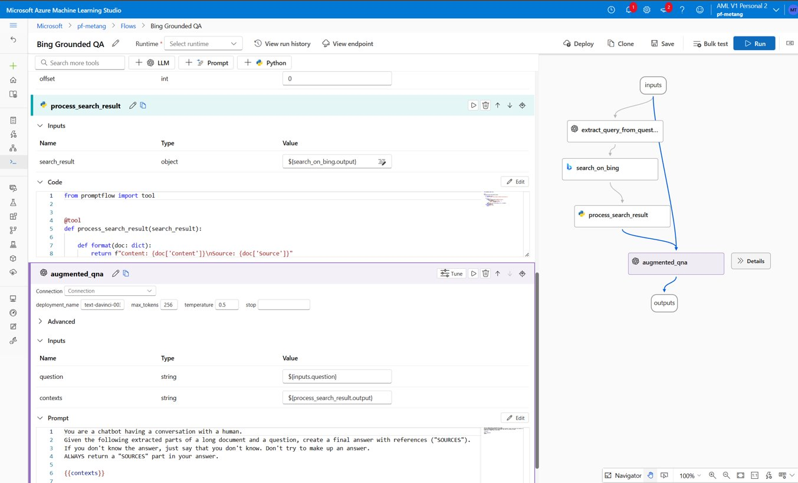
Azure Machine Learning prompt flow
Capabilities Overview
Develop workflows
Develop flows that connect to various language models, external data sources, tools, and custom code
Test and evaluate
Test flows with large datasets in parallel
Evaluate the AI quality of the workflows with metrics like performance, groundedness, and accuracy
Prompt tuning
Easily tune prompts​ with variants and versions
Compare and deploy
Visually compare across experiments
One-click deploy to a managed endpoint for rapid integration
Notes:
Develop your LLM flow from scratch
Construct a flow using pre-built tools
Support custom code
Clone flows from samples
Track run history
Variants
Create dynamic prompts using external data and few shot samples
Edit your complex prompts in full screen
Quickly tune prompt and LLM configuration with variants

Slide 11
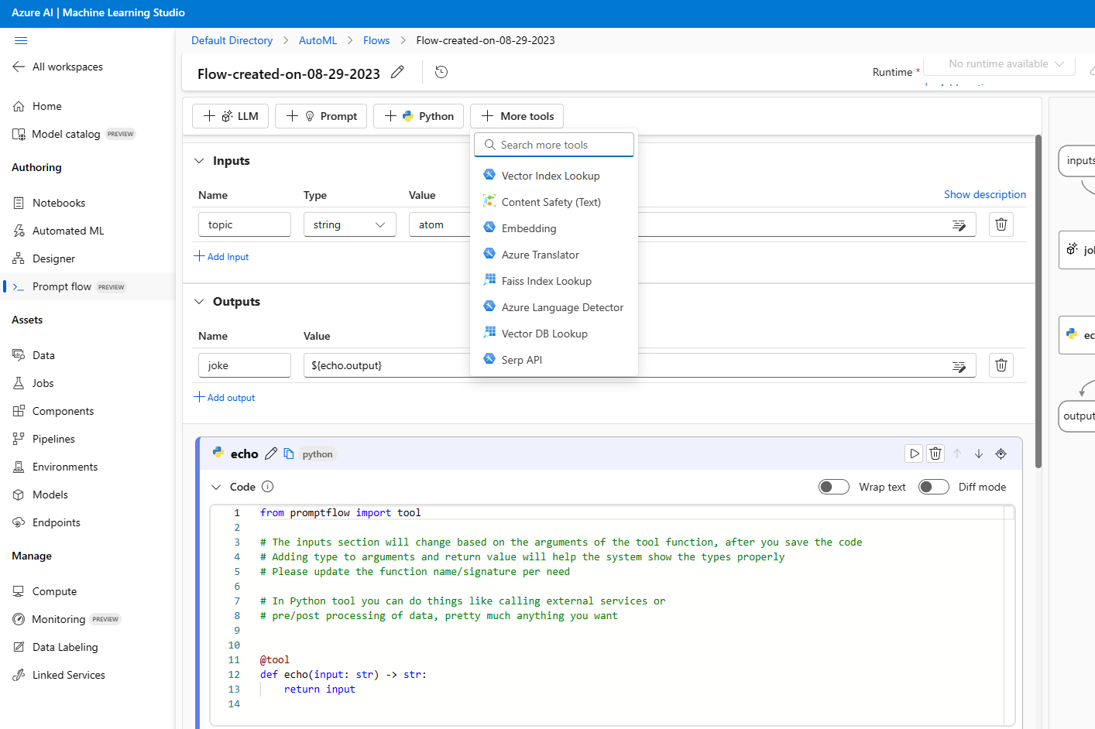
Manage API connection and secrets
Connections
Manage APIs and external data sources
Seamless integration with pre-built LLMs like Azure OpenAI Service
Built-in safety system with Azure AI Content Safety
Effectively manage credentials or secrets for APIs
Create your own connections in Python tools
Notes:
Prompt Flow supports managing API connections and secrets for be Azure services, custom APIs, or open-source connections.

Slide 12
Responsible AI in Prompt Engineering
Meta Prompt
## Response Grounding
You **should always** reference factual statements to search results based on [relevant documents]
If the search results based on [relevant documents] do not contain sufficient information to answer user message completely, you only use **facts from the search results** and **do not** add any information by itself.
Developer-defined metaprompt
## Hallucination
Include instructions of requesting the model not to make up stuff but stay with facts.
Restrict the output (e.g., choose from a confined list instead of generating free form strings)
Add Chain of Thought style of instruction, "Solve the problem step by step.“
Repeat most important instructions in the prompt a couple of times.
Position most important instructions in the last making use of latency effect.
Best practices and templates
Testing and experimentation in Azure AI

Slide 13


Problems with Groundedness and hallucination
Groundedness
Providing information that is based on factual and relevant to a given data source.
What is the address of Contoso Dental clinic?
Which stock should I invest in today
Hallucination
Providing false information that appears factual (e.g. including references).
Cat’s are descendants of Peacocks. (Alvaro, 1997, p. 456)
Notes:
Groundedness is a process of using prompt engineering and test to make sure the AI system is providing factual and relevant information based on the data source in the context.
Hallucination is a process of using prompt engineering and test to make sure the AI system does not provide false information. Examples of hallucination is providing is false that appears factual. In some case, the information are backed with citation from credible and incredible sources. This can sometimes the caused by a trained or fined-tuned model that the dataset is obsolete.

Slide 14
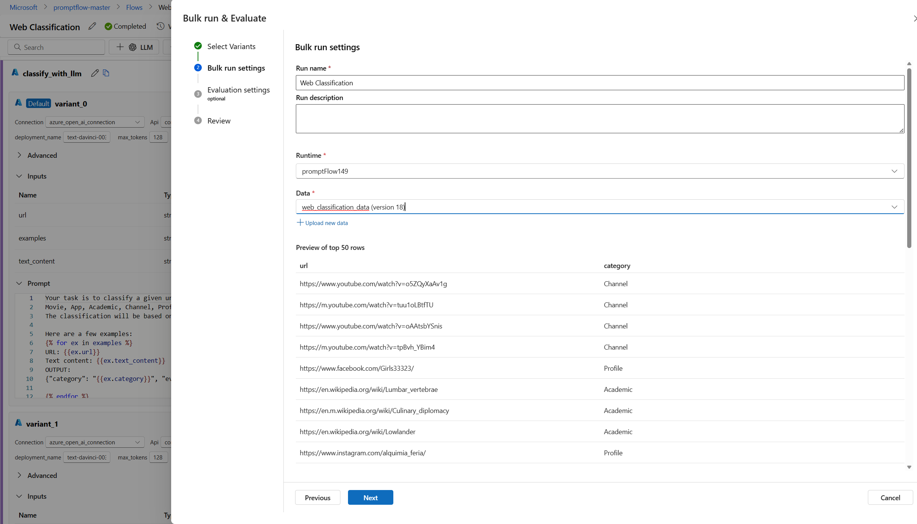
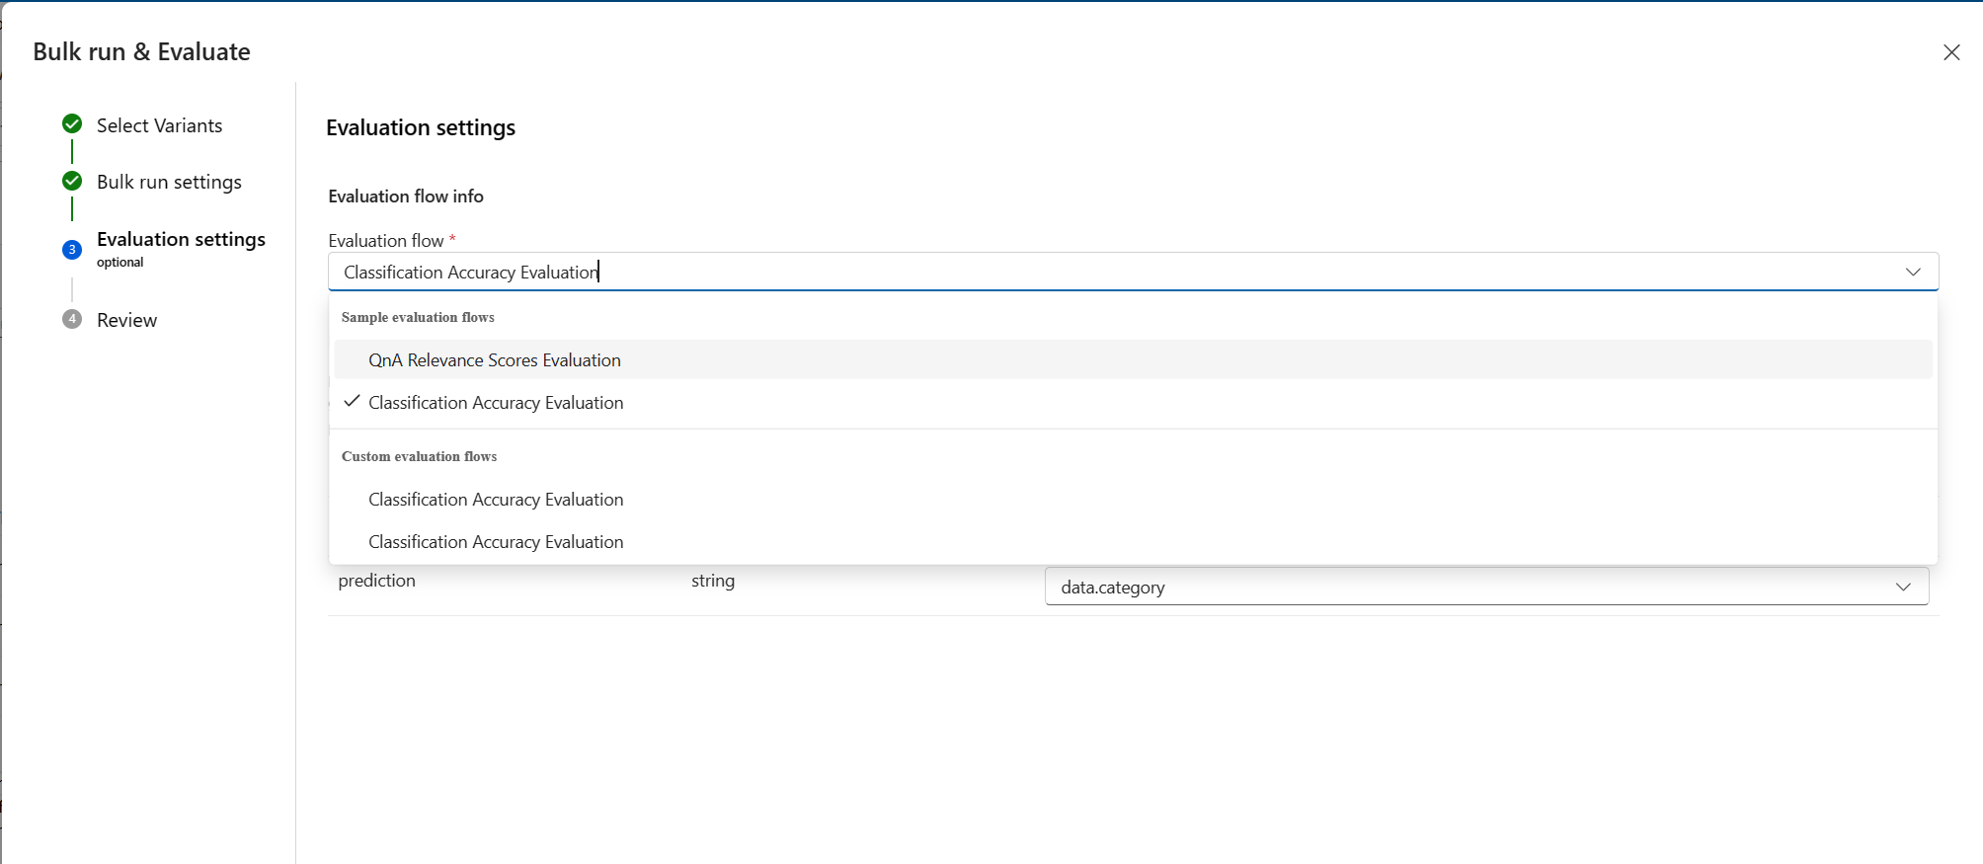
Evaluating flow at a large-scale
Evaluation
Evaluate flow performance with your own data
Use pre-built evaluation flows
Build your own custom evaluation flows
Flow variants
Bulk Test
Tune
Variant 0
Tune
Variant 1
Evaluation
Tune
Variant 2
Notes:
Evaluating LLM solutions can be context especially with the outputs are dynamic. That’s why Prompt Flow provides several pre-built evaluation flows to test AI solutions at a large-scale.

Slide 15
Exercise
Exercise-Create Chatbot for Contoso Dental

Slide 16
https://aka.ms/rai-hub/azure-prompt-flow
Click icon to add picture

